Slide 1
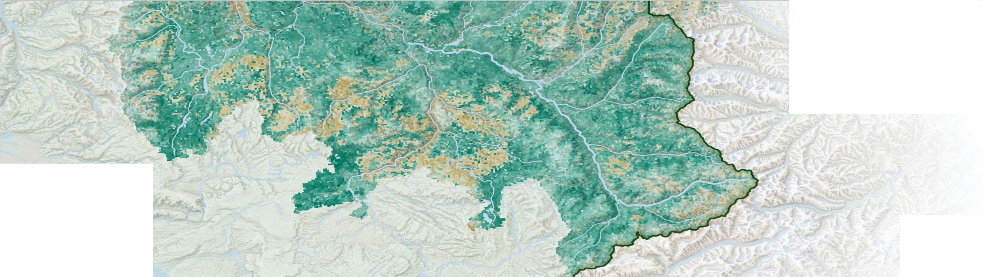


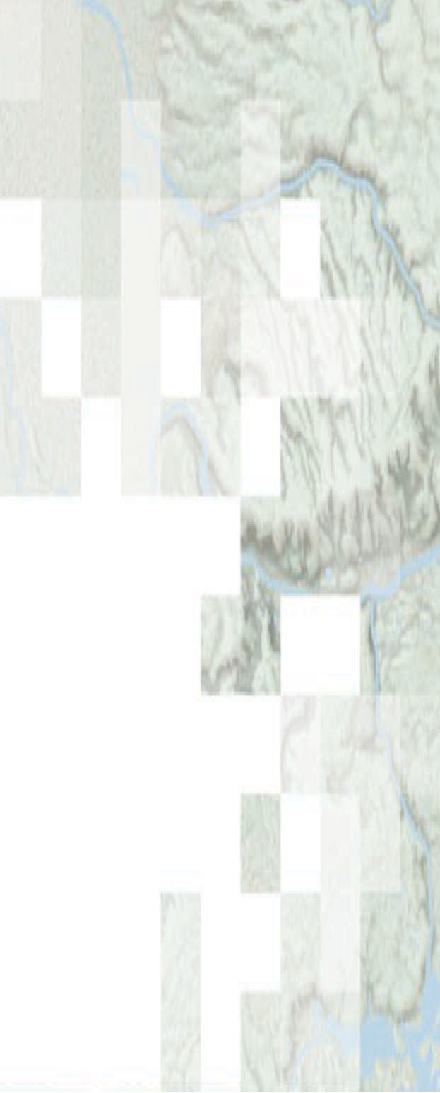


!"#$%&"' )*+%&",#$-. "&/ 01"-* )/2$&$.#+"#$%&
Species Distribution Modeling with Remote Sensing
Amber McCullum, Juan Torres-Perez, Zach Bengtsson
Aug 12, 2021

Slide 2
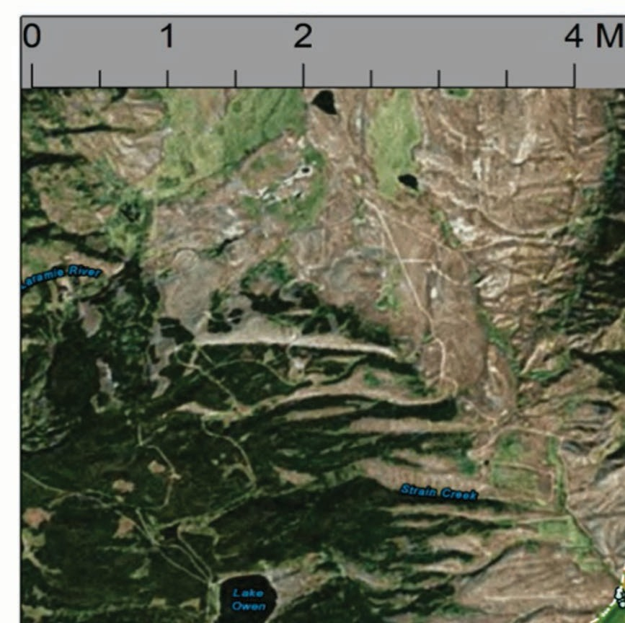
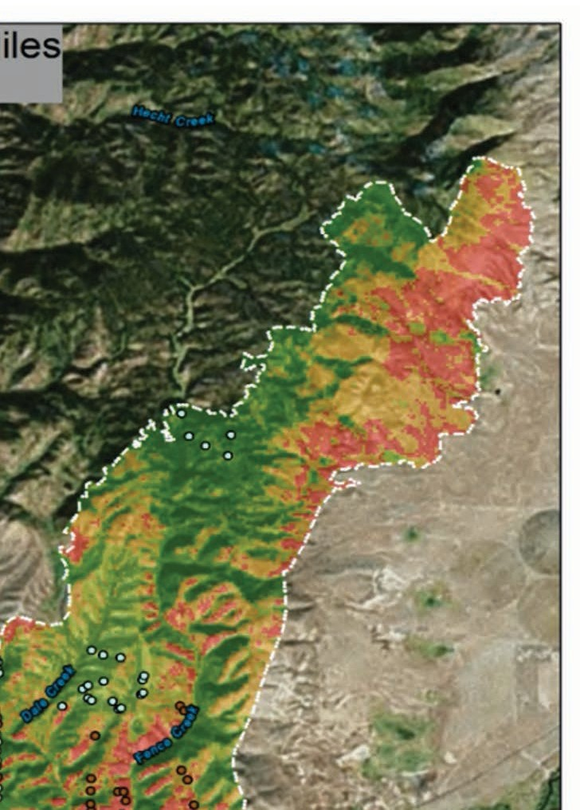
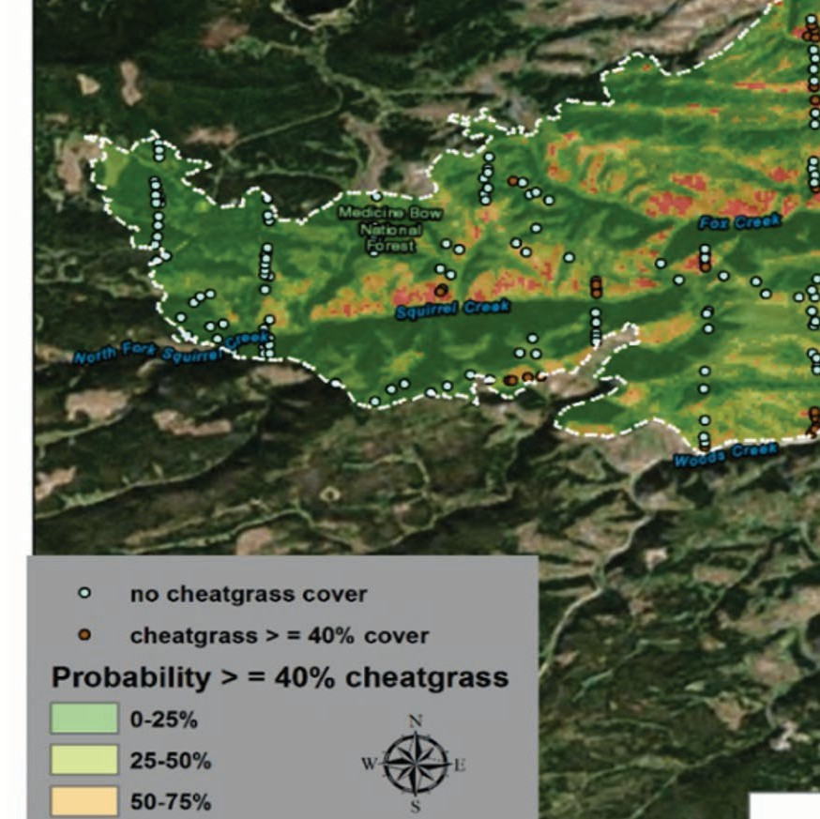
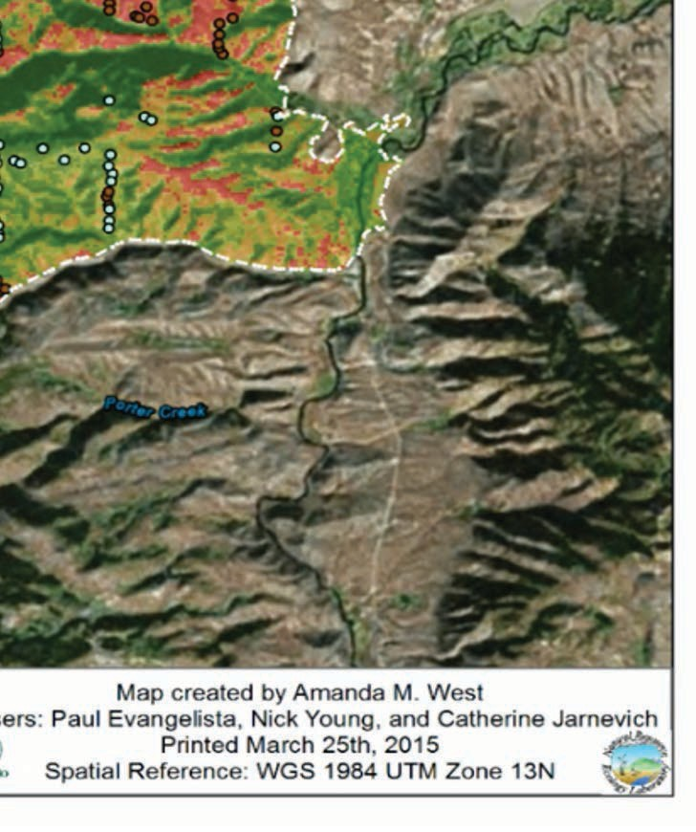
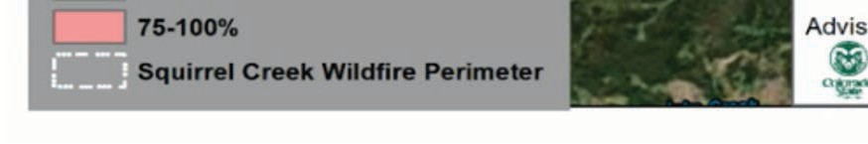
SDM Overview
Week 1 – SDM overview
Species Distribution Models (SDMs) overview
Occurrence data – IndOBIS by Johnny Konjarla
SDM environment data overview
Application lecture by Ben Best
SDM occurrence data overview
Week 2 – SDMs in R
Occurrence Data
Environmental Variables
Methods and Models
Case Study Examples
Question and Answer Session
4

Slide 3
Methods and Models

Slide 4

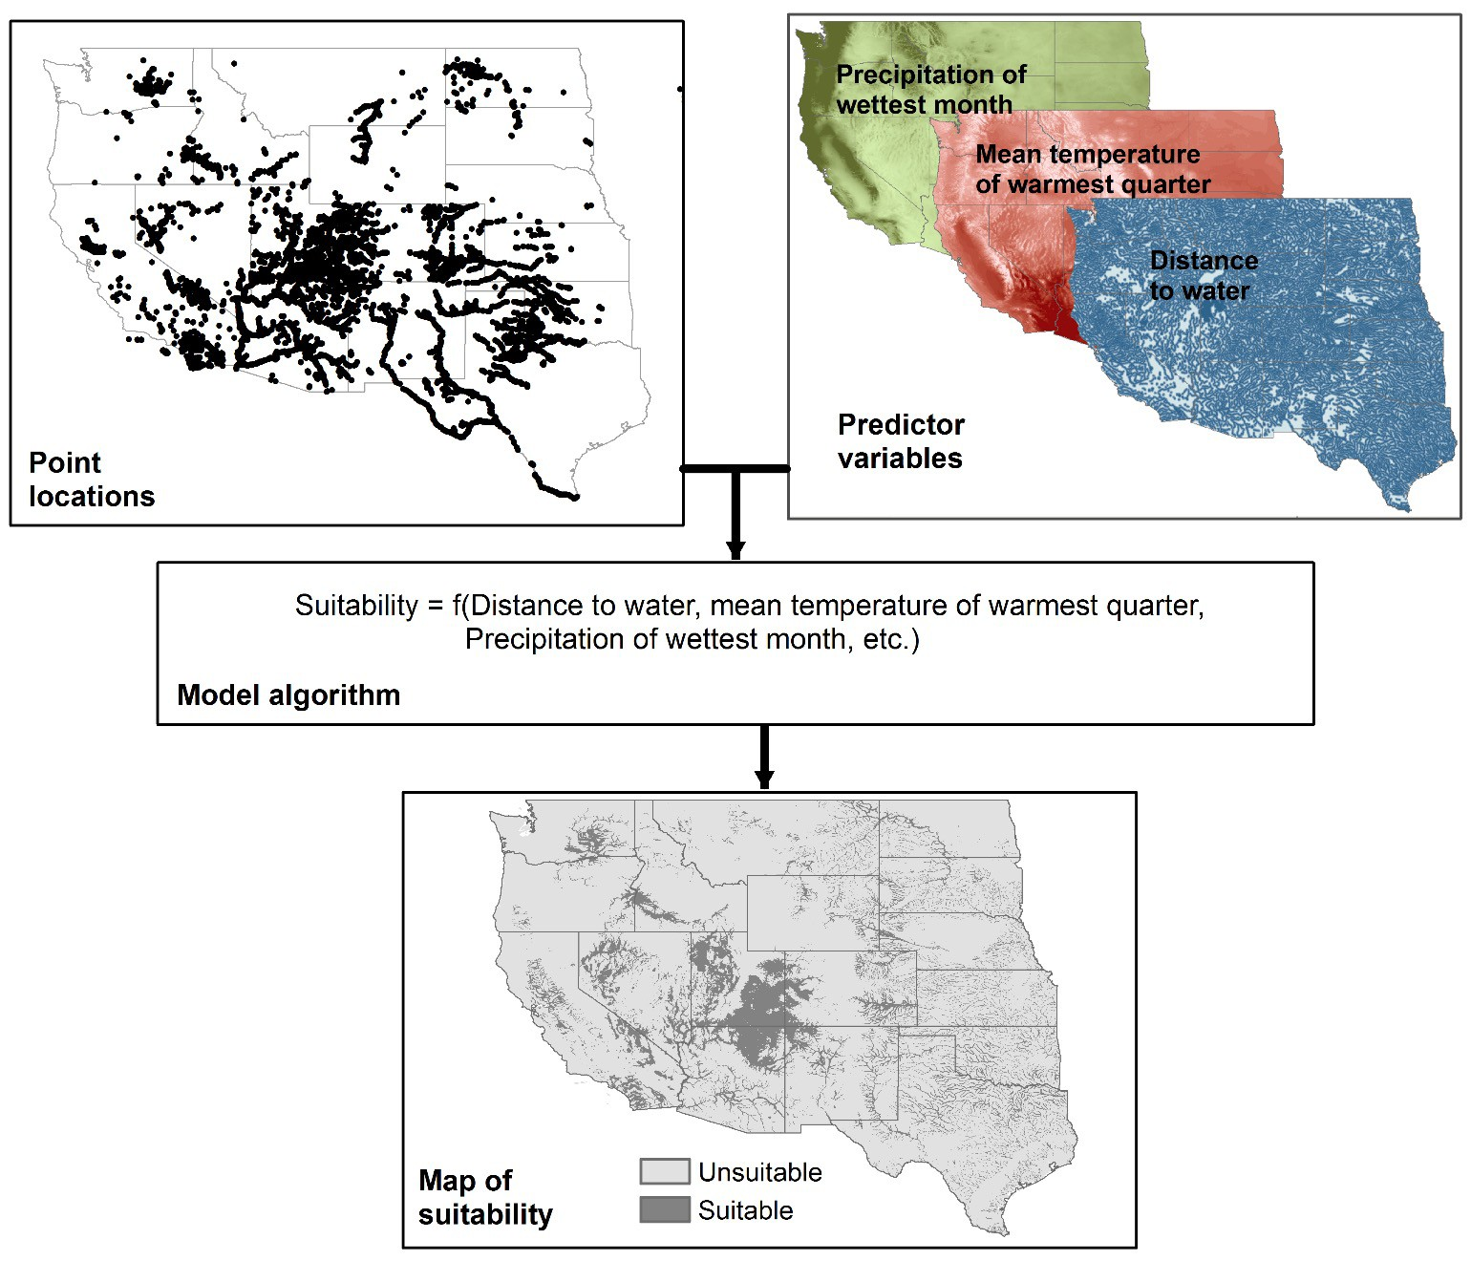


Methods and Models
Fit mathematical functions, describing species distributions in environmental space, for each of n environmental variables
Then generate predictive maps of species distributions in geographic space using these functions
!"#$%&'() %* ",- ./01
NASA’s Applied Remote Sensing Training Program
46

Slide 5
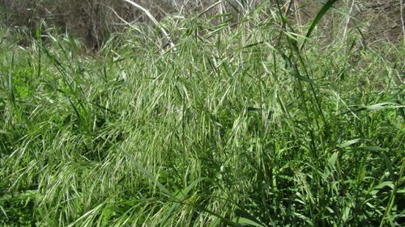
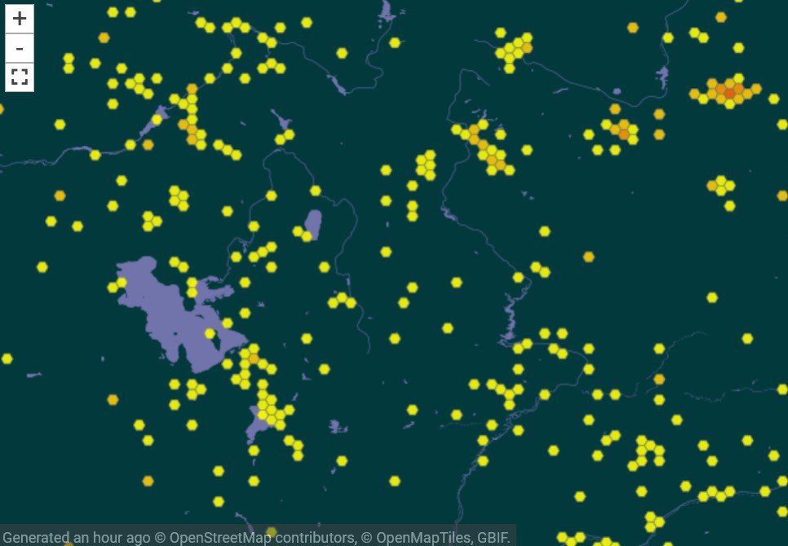
Modeling Success: Key Factors
Input Data: availability of sufficient and reliable species data
Equilibrium: a species occurs in all suitable areas, while being absent from all unsuitable areas
" Dependent on biotic interactions and dispersal ability
Sampling Adequacy: The extent to which the observed occurrence records provide a sample of the environmental space
Model: Type, complexity, and accuracy of the models used
Bromus Tectorum (cheatgrass) from iNaturalist
NASA’s Applied Remote Sensing Training Program
Bromus tectorum (cheatgrass) sampling from GBIF, near Salt Lake City Nevada.
47

Slide 6
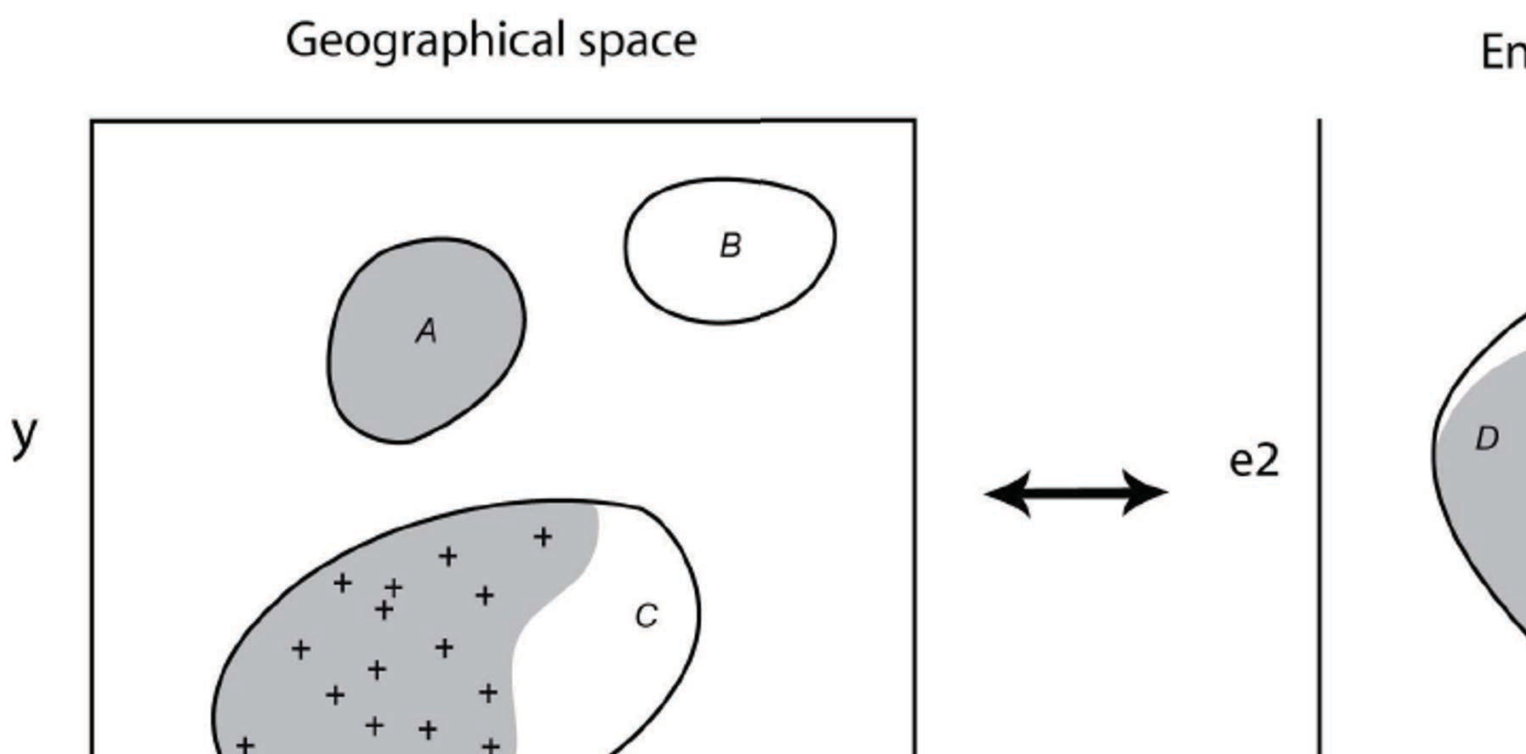
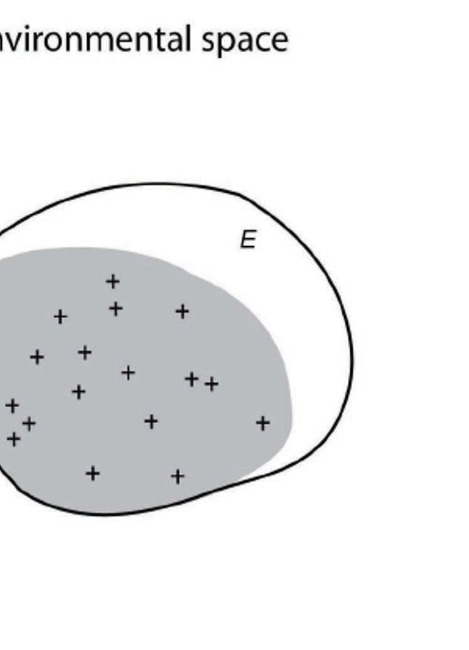
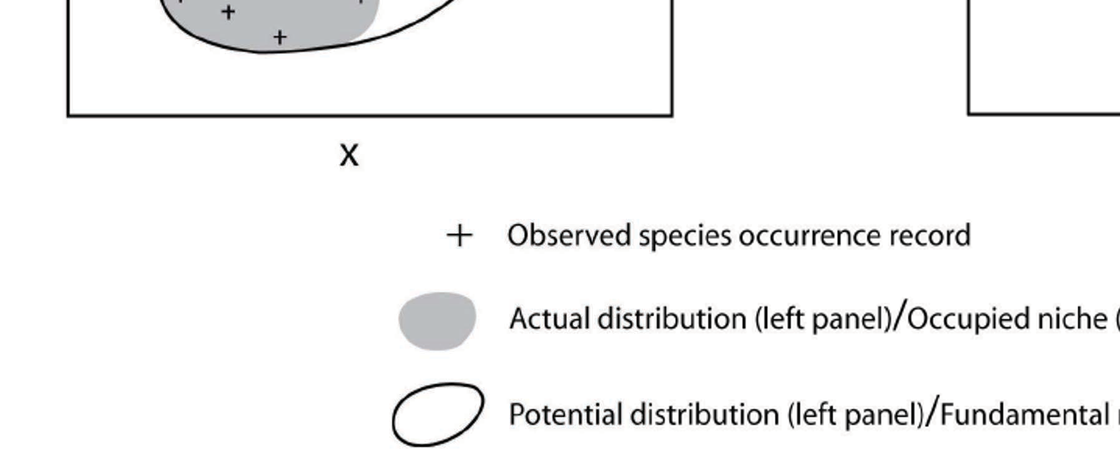
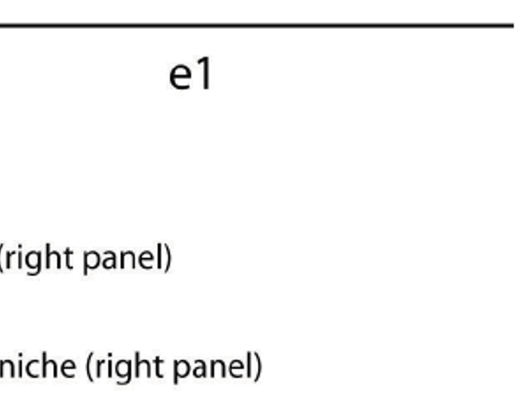
Modeling Approach
Pearson, R.G. 2007. Species’ Distribution Modeling for Conservation Educators and Practitioners.
Synthesis. American Museum of Natural History. Available at http://ncep.amnh.org.

Slide 7
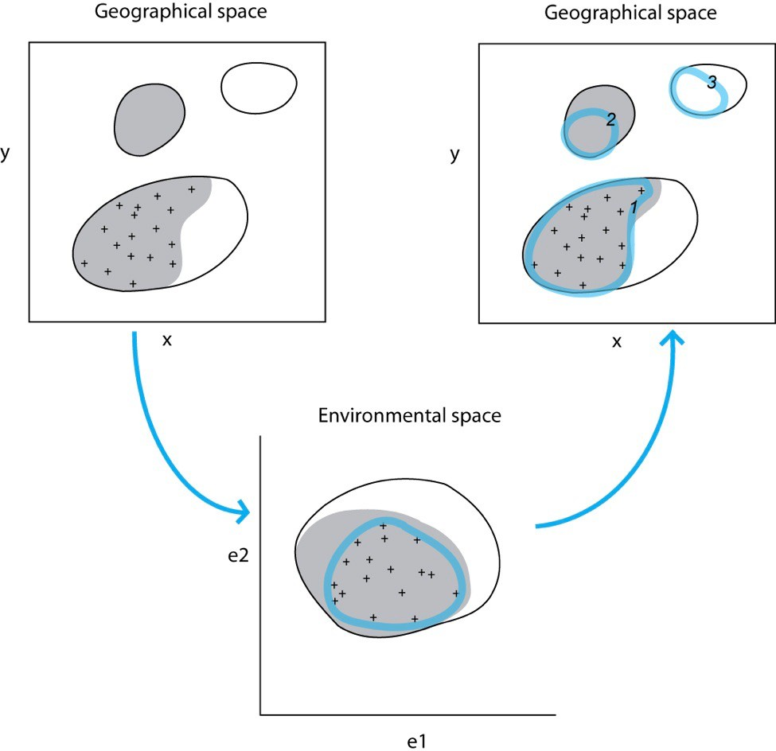
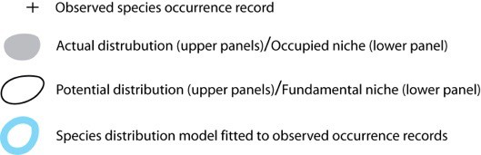
Modeling Approach
General approach
Pearson, R.G. 2007
Pearson, R.G. 2007

Slide 8
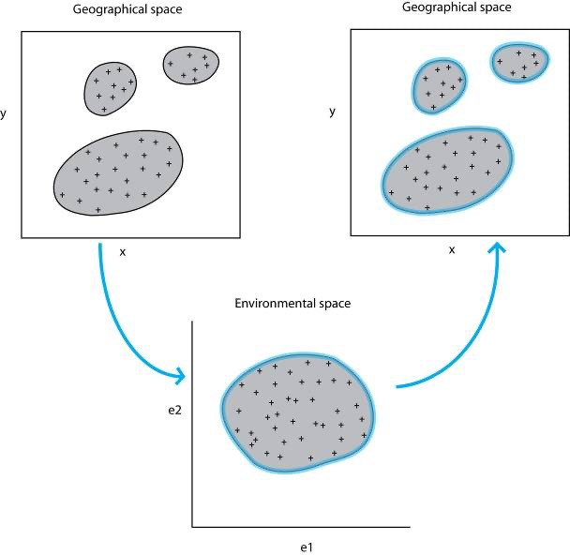
Modeling Approach
Equilibrium and good sampling
Pearson, R.G. 2007

Slide 9
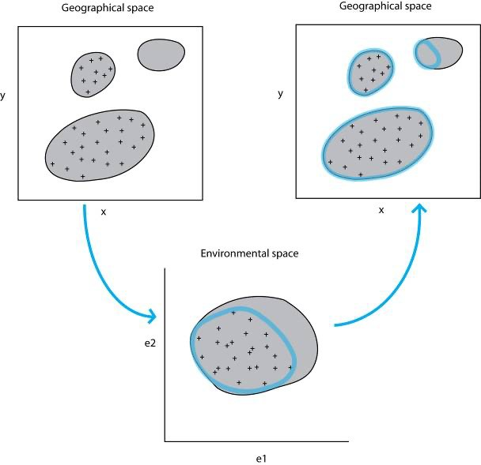
Modeling Approach
Equilibrium and poor sampling
(in both geographic
and environmental space)
Pearson, R.G. 2007

Slide 10

Modeling Approach
Equilibrium and poor sampling in geographic space and good sampling environmental space
Pearson, R.G. 2007
Pearson, R.G. 2007

Slide 11
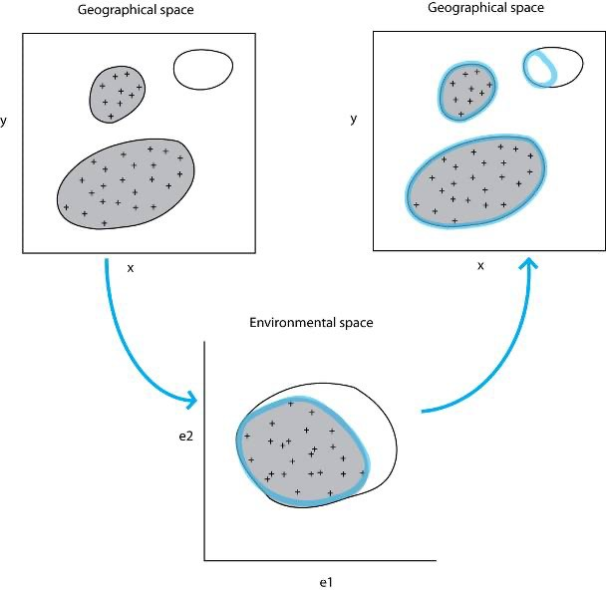
Modeling Approach
Low Equilibrium and good sampling
(in both geographic and
environmental space)
Pearson, R.G. 2007
Pearson, R.G. 2007
Pearson, R.G. 2007

Slide 12
Methods and Models
Profile Techniques: Use environmental distance to know sites of occurrence
" Gower Metric (DOMAIN)
" Ecological Niche Factor Analysis (BIOMAPPER)
Regression-Based Techniques: Linear Models
" Generalized Linear Models (GLMs)
" Generalized Additive Models (GAMs)
Machine-Learning Techniques: Iterative “learning” algorithms, inspired by the workings of the brain
" Genetic Algorithm for Rule-set Production (GARP)
" MAXENT

Slide 13
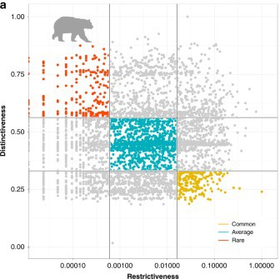
Gower Metric
Correlation between response and predictor variables
" Clusters
Assigns each cell in the output layer an average multivariate distance (Gower Metric) between that cell and the closest presence cell in the training set
Uses only presence points
Distance rescaling used to compare with probability-based techniques
Example: DOMAIN
Geographical Restrictiveness: Each species is represented by a dot, ecologically rare species are in red, average in blue, and common in orange. Image Credit: Konowalik and Nosol, 2021

Slide 14
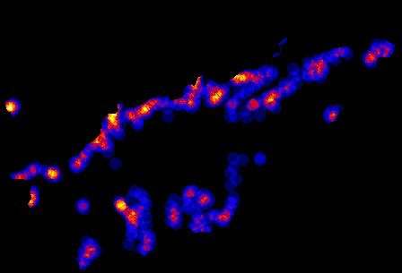
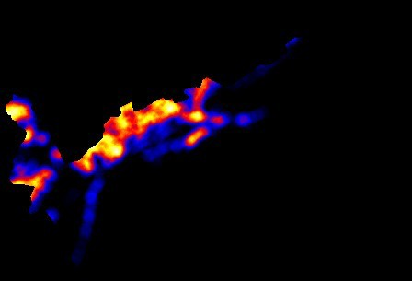
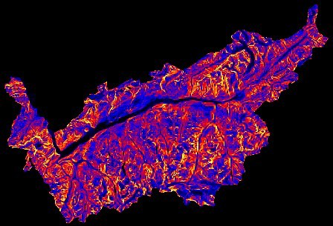
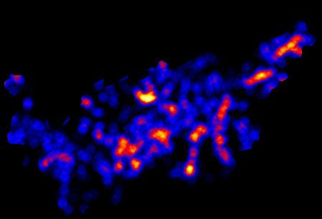
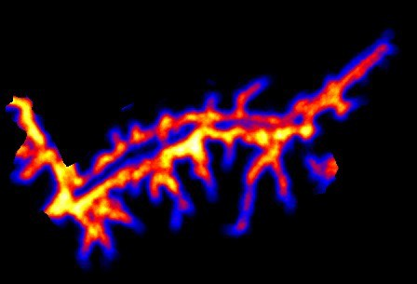
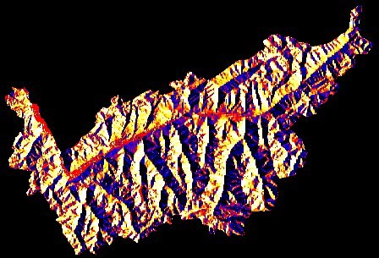
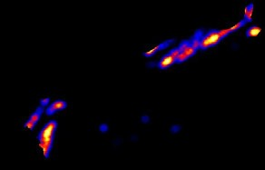
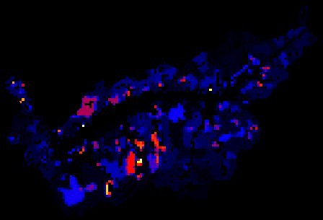
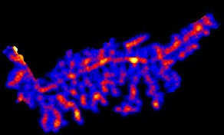
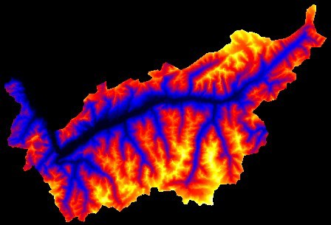
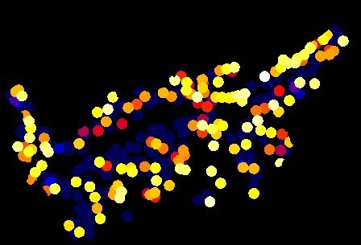
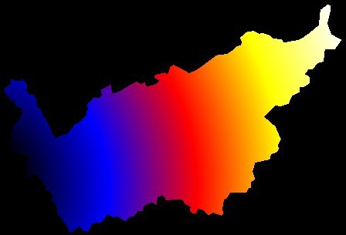
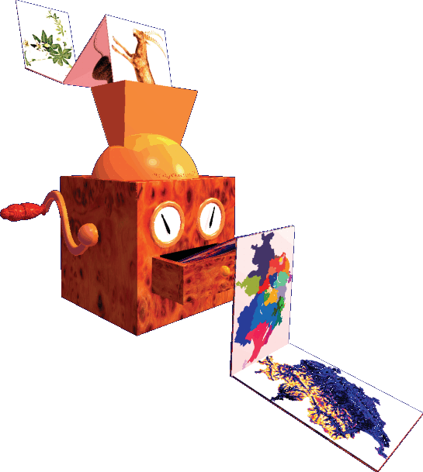
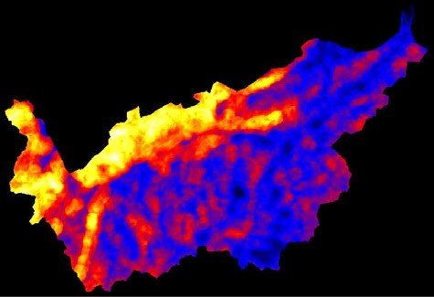
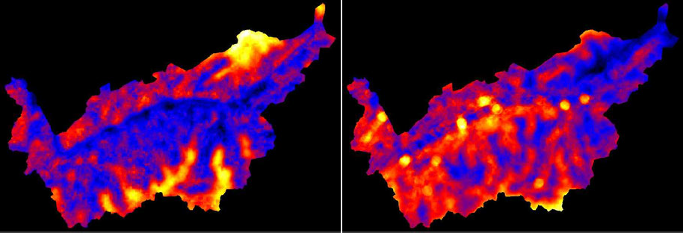
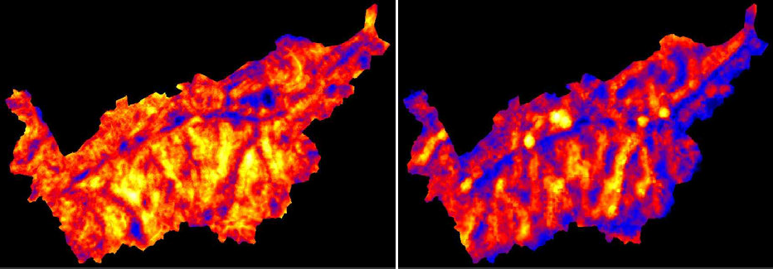
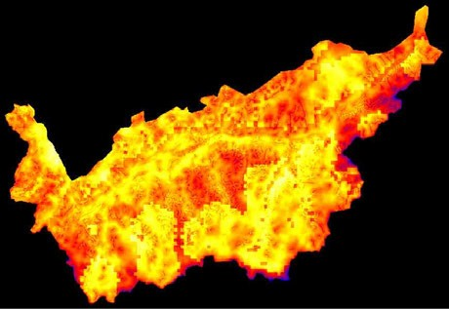
Ecological Niche Factor Analysis (ENFA)
!"#$
!"#$%&'
($
)+,- #
Computation of the factors explaining the major part of a species environmental distribution
Presence-only data
Habitat Suitability Index (HSI)
" Value inversely proportional to weighted mean distance of the cell to the median of each ENFA factor
Example: BIOMAPPER https://www2.unil.ch/bioma pper/
)*(#
.,(#/ #
)*(# #
5/-
#*'
'/
/0+# '
!"#$%&
24 Predictors
)*+(
"&$
"%
-
%&'
' #(
%&'
#(
($
,-$.
+&"'(
)*+(
)4##
"&$
)+,- #
%&'
#(
01/'2 ', (#+#&/#
/1'#
!"
($
!"#$
#$%&'
5/-
#*'
6 Factors = 80% of Information
ENFA

Slide 15
Regression Analysis
Generalized Linear Models (GLMs)
" Based on relationship between mean of the response variable and the linear combination of explanatory variables
" Multiple types of distributions can be used
" Flexible
Generalized Additive Models (GAMs)
" Similar for GLMs but assumes functions are additive and components are smooth
" Data-driven
" Can handle non-linear relationships
Review paper on regression analysis for SDMs (Guisan et al, 2002)
" https://www.sciencedirect.com/science/article/pii/S0304380002002041

Slide 16
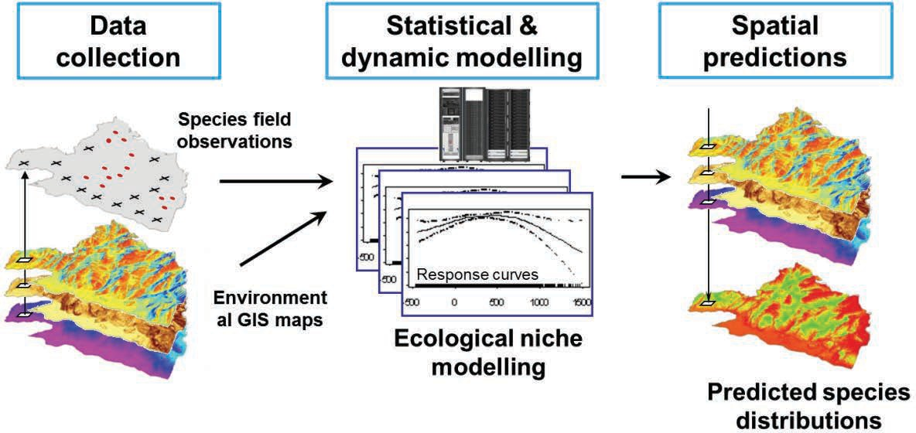
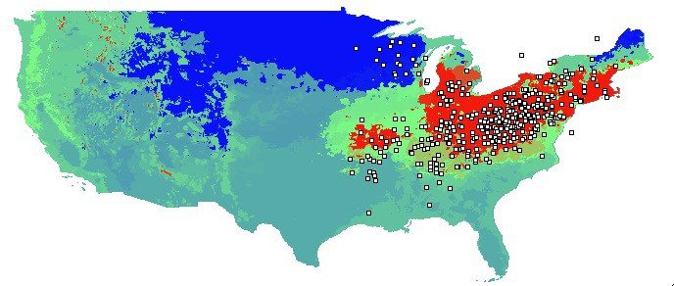

Genetic Algorithm for Rule-set Production (GARP)
Ecological niche model for species
" Similar to the first SDM: BIOCLIM
Inputs: Presence only point locations and geographic layers of environmental parameters
Output: Predicted species distribution
Peterson, A. T. (2003)
Probability distribution map of a bird species (Cerulean warbler, Dendroica cerulea) created by DesktopGarp. Red is high probability, green intermediate, and blue is low.

Slide 17
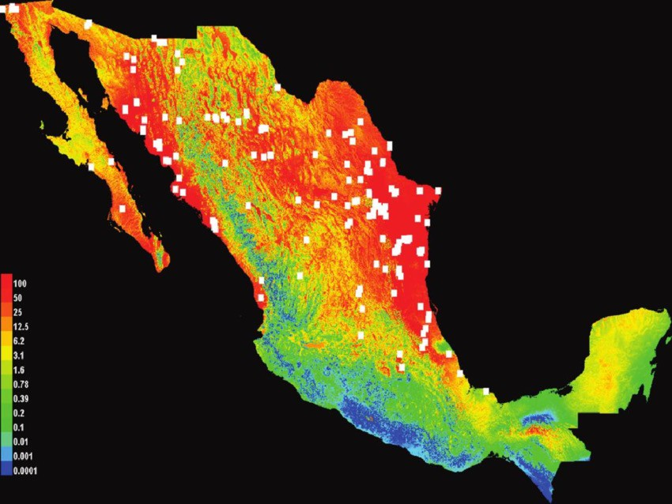
MAXENT
Predicts the potential distribution of a species
" Explores the relative suitability of one place over another using the maximum entropy principle
" Entropy = Randomness
" Maximizes randomness by removing patterns
Uses machine Learning
Uses only presence points
Areas in red are the most likely to have suitable habitat for sunflowers. The white squares represent modern wild sunflower collections. Image Credit: Lentz et al, 2008
https://biodiversityinformatics.amnh.org/open_source/maxent/

Slide 18
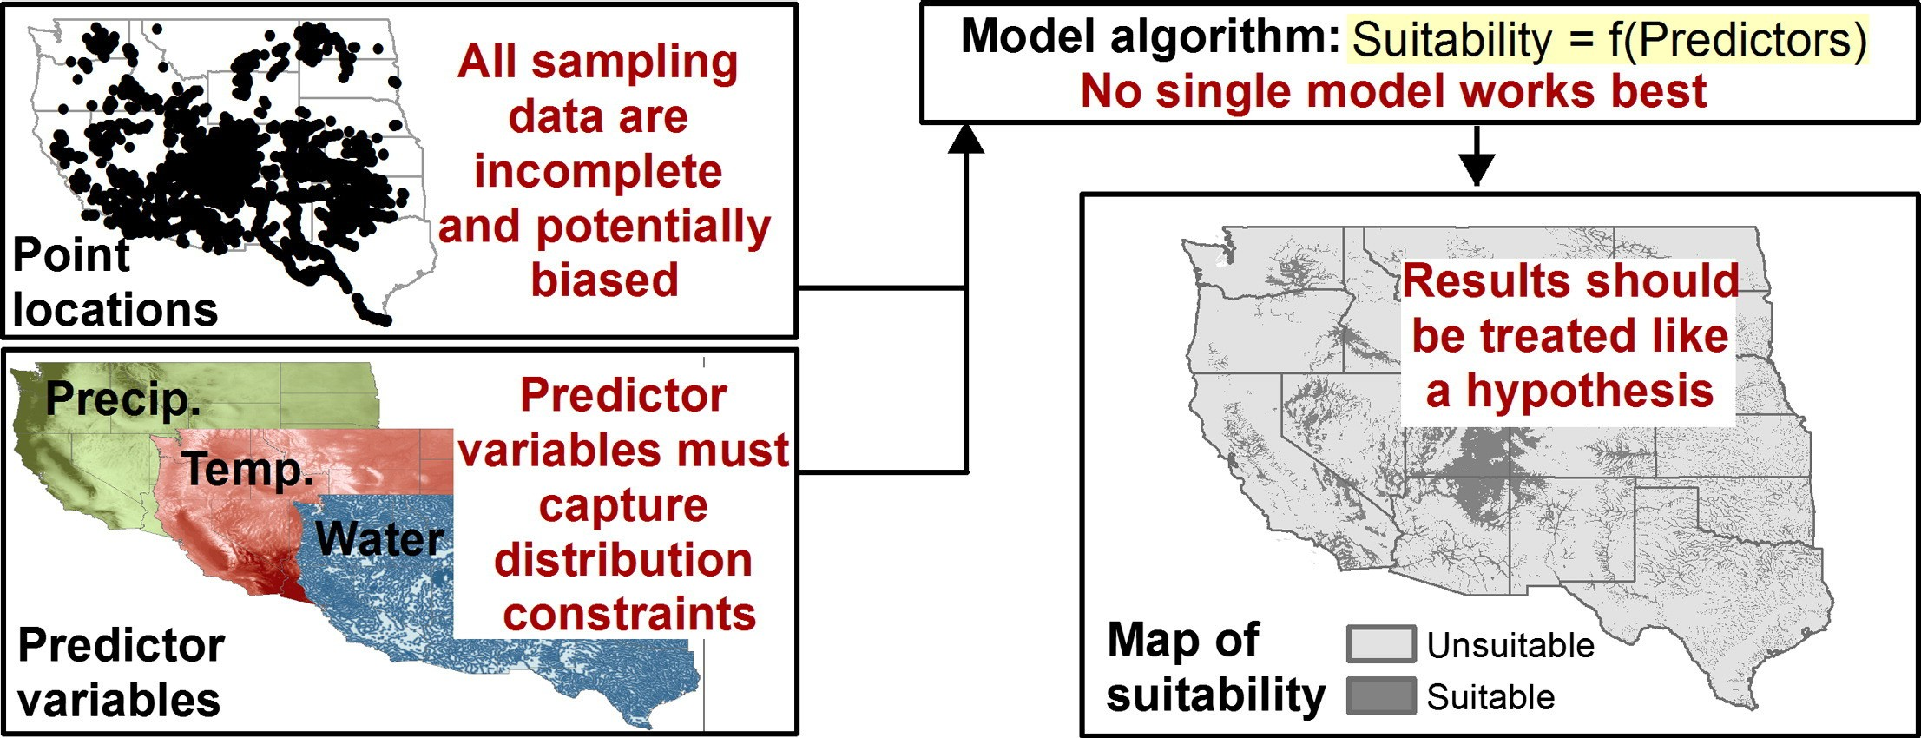
Limitations of SDMs
Jarnevich et al, 2015

Slide 19
Case Study Examples

Slide 20
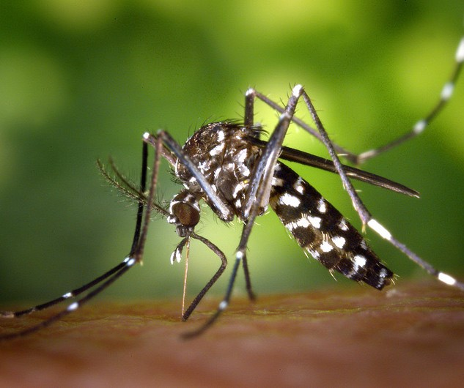
SDM Case Study Example: Mosquitos in Europe
NASA DEVELOP Project
An Interactive Model of Mosquito Presence and Distribution to Assist Vector-Borne Disease Management in Western Europe
https://develop.larc.nasa.gov/2018/spring/ WesternEuropeHealthAQII.html
Community Concerns:
Mosquito-borne disease kills over one million people a year
Zika, Dengue, Chikungunya, Yellow Fever, Malaria
Mosquito habitat range is spreading
Mosquito Alert Spain

Slide 21
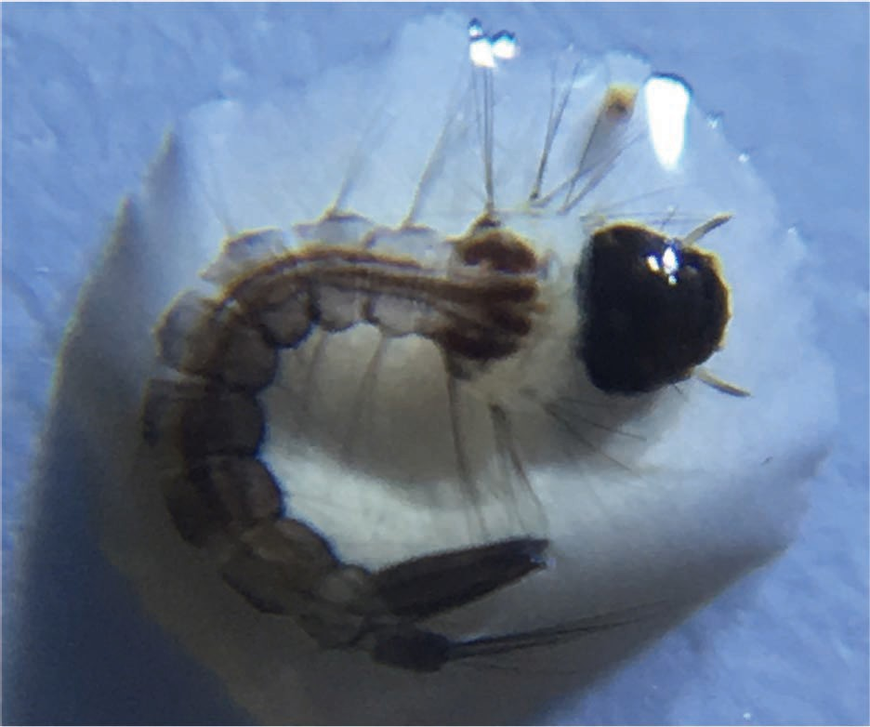
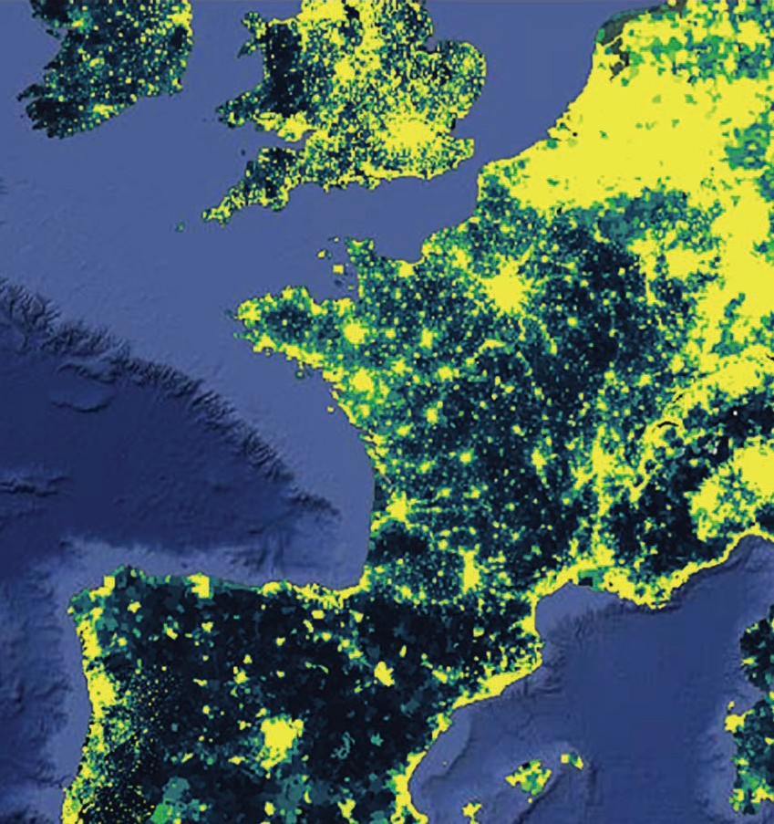
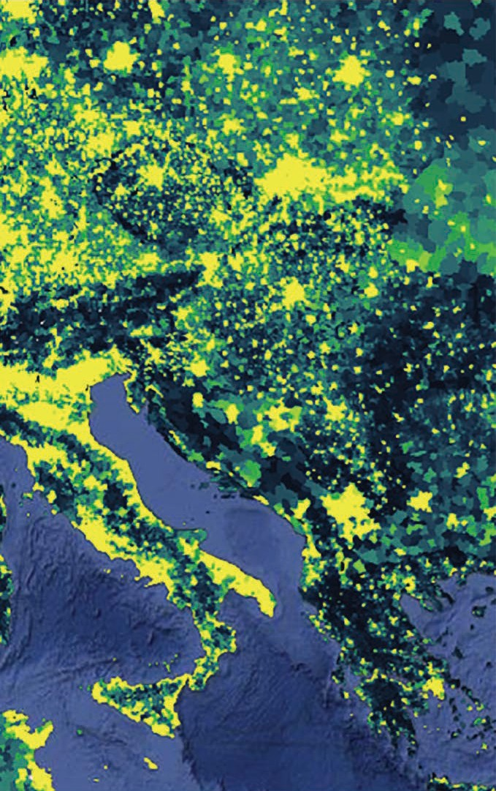
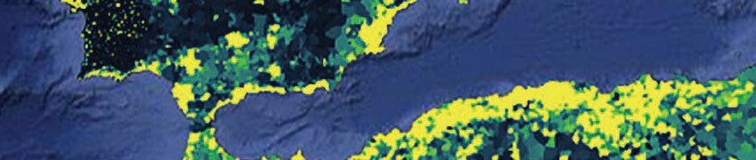
Mosquitos in Europe: Project Overview
Project Goals:
Integrate citizen science data and NASA Earth observations to make the information publicly accessible
Create an interactive map showing mosquito habitat suitability
Overlay results with transportation, population, and public health data
Study Area: Western Europe
Study Period: June 2016 – September 2017
GLOBE | Dorian
Janney
NASA DEVELOP

Slide 22






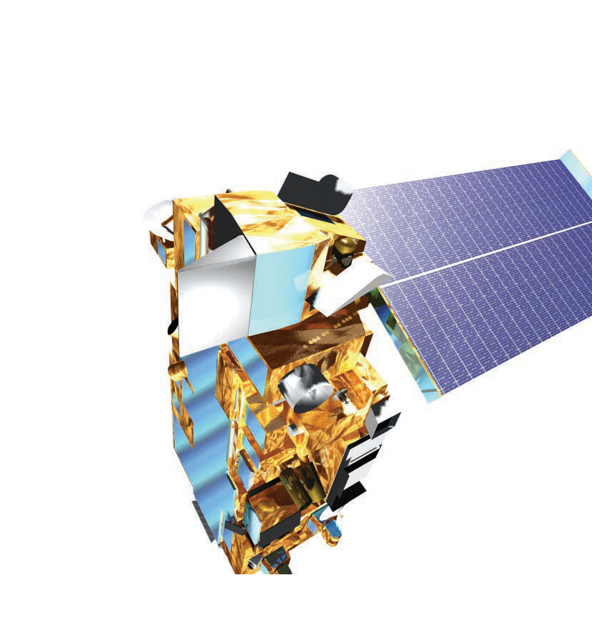

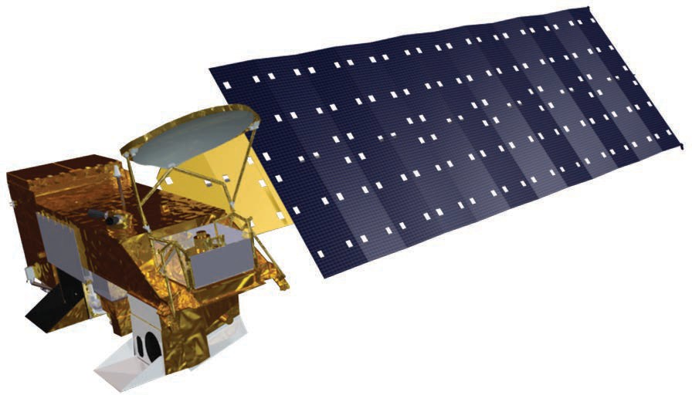
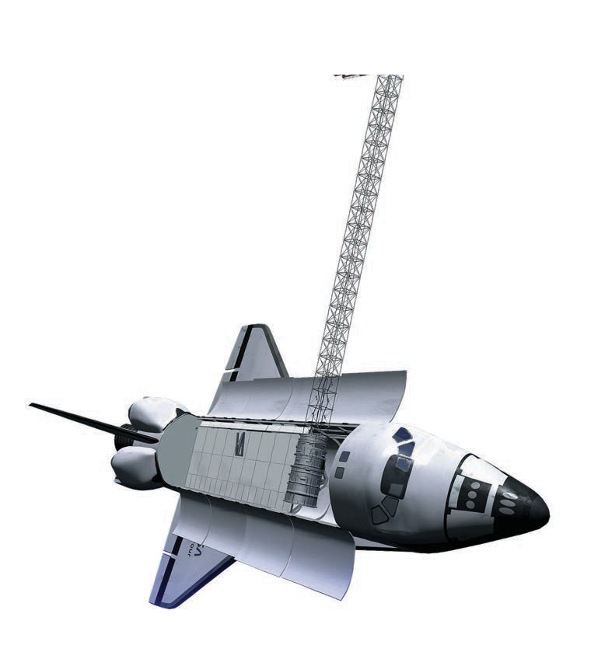
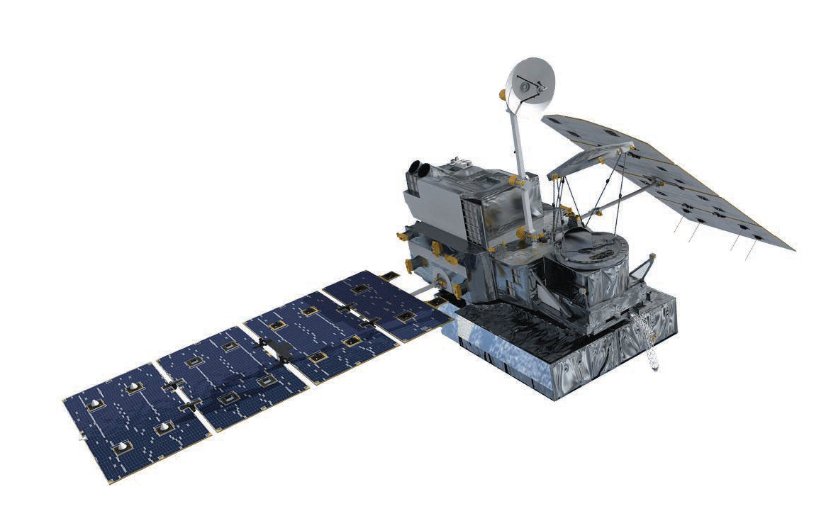

Mosquitos in Europe: Environmental Variables
Elevation
Humidity
Land Surface Temperature
Normalized Difference Vegetation Index (NDVI)
Precipitation
Soil Moisture
Land cover
Terra
Aqua
SRTM
GPM

Slide 23




Mosquitos in Europe: Methodology
Environmental Variables
Habitat Suitability
Model Algorithm (MaxEnt)
Presence Locations via Citizen Science

Slide 24

Mosquitos in Europe: Habitat Suitability
The MaxEnt model revealed relationships between mosquito presence and the environmental variables.
Mosquito presence positively correlated with:
" NDVI
" Homogenous land cover and greenness
" Temperature
!"#" %&'&()*

Slide 25


















Slide 26

SDM Case Study Example: Red Spruce in West Virginia
NASA DEVELOP Project: Forecasting Red Spruce Restoration Using NASA Earth Observations to Support the USFS Monongahela National Forest
https://develop.larc.nasa.gov/2019/summer/MonongahelaN ationalForestEco.html
Community Concerns:
Red Spruce declines due to coal mining, logging, and wildfires
Red Spruce restoration is critical for:
Biodiversity
Water Quality
Flood Mgmt.
Carbon Stocks
Project Goals:
Identify historical extent of red spruce from 1989 to 2018
Create maps of red spruce locations and suitable locations in Monongahela Forest, West Virginia
Forecast site suitability and forest cover to 2040
Image Credit: USFS

Slide 27




















Red Spruce in West Virginia: Land Cover Mapping
NDVI
NDMI
Slope
Aspect
Elevation
Multispectral Bands (Blue to !"#$!)
CTA
Red spruce Deciduous Grass
Soil Water Urban

Slide 28



























Red Spruce in West Virginia: Time Series Analysis
2018 to 2040
LAND CHANGE MODELER
Persistent Spruce Persistent Change to Grass Change to Soil
Change to Spruce Change to Urban Change to Water Change to Decid
1989
2018
NASA’s Applied Remote Sensing Training Program
70

Slide 29

Red Spruce in West Virginia: Suitability Analysis
Habitat Suitability:
Sharp’s Knob Restoration Area
Inputs | Fuzzy Memberships
Elevation | Linear
Slope | Small
Frost Days | Large
Growing Degree Days | Small
Average Annual Temperature | Small
Average Annual Precipitation | Large
Distance to Road | Linear
Soil pH | Small
Low Suitability
Moderate Suitability High Suitability
Very High Suitability Red Spruce Extent
Roads Streams
0
1.5
3
6
Kilometers

Slide 30



Red Spruce in West Virginia: Forecasting and Connectivity
2018 to 2040
Change to Spruce No Change Persistent Spruce Change Other
5 !"
Spruce Core
50 !"
Low
High
Forecast Modeling
Connectivity Potential

Slide 31
Summary
Species Distribution Models (SDMs) allow us to assess the suitability of a habitat for a species.
SDMs primarily use environmental data and occurrence data to build a model for predictions of habitat suitability.
" Remotely sensed data can be used for a variety of environmental data inputs.
There is no universally correct or universally applicable method.
Methodologies must be adapted to:
" Ecological and biogeographical situation
" Meet the study goals
" Use available data
Next Session: Using Wallace to Model Species Niches and Distributions

Slide 32
Contacts
Trainers:
" Juan Torres-Pérez: juan.l.torresperez@nasa.gov
" Amber McCullum: amberjean.mccullum@nasa.gov
" Zach Bengtsson: bengtsson@baeri.org
Follow us on Twitter @NASAARSET
Training Webpage:
" https://appliedsciences.nasa.gov/join-mission/training/english/arset-species- distribution-modeling-remote-sensing
ARSET Website:
" https://appliedsciences.nasa.gov/what-we-do/capacity-building/arset

Slide 33



Thank You!

